Slide 1

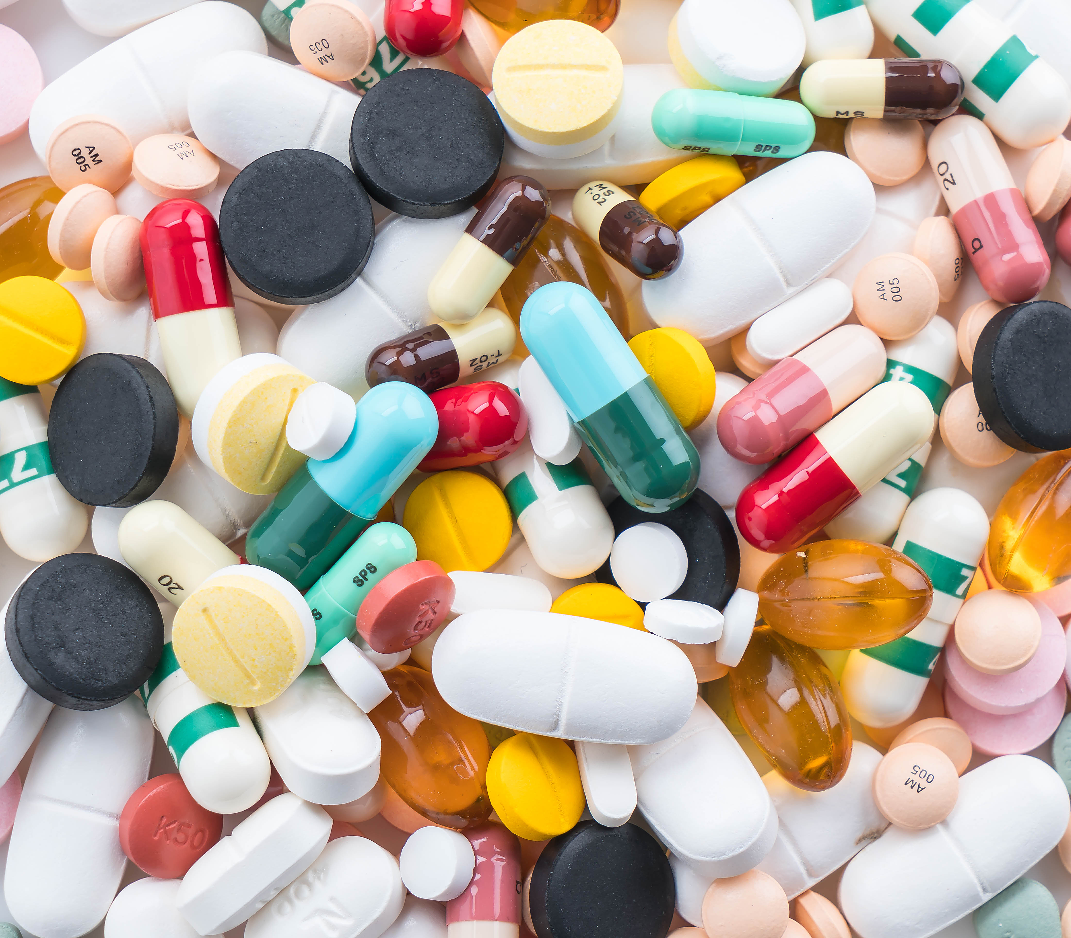
Fast medication automation
Team Rolex
Bojana Chen
Sebastian Fernandez
Magdalena Hardegger
Gerardo Romeny
Team-Project DigitaliZation of Business Processes, AS 2023
Picture:. https://www.freepik.com/free-photo/packings-pills-capsules-medicines_1178867.htm#query=medication&position=6&from_view=search&track=sph&uuid=e8115ce7-5bd6-4dc1-b773-868d6d0d55f9">Image by topntp26

Slide 2

Problem: Prescription handling
Medication errors are numerous
Adverse events owing to medication: about 20 000 hospitalizations/year in Switzerland
Increasing: - number of medications
- drug interactions
- healthcare costs
Picture: von Unbekannter Autor ist lizenziert gemäß CC BY

Slide 3
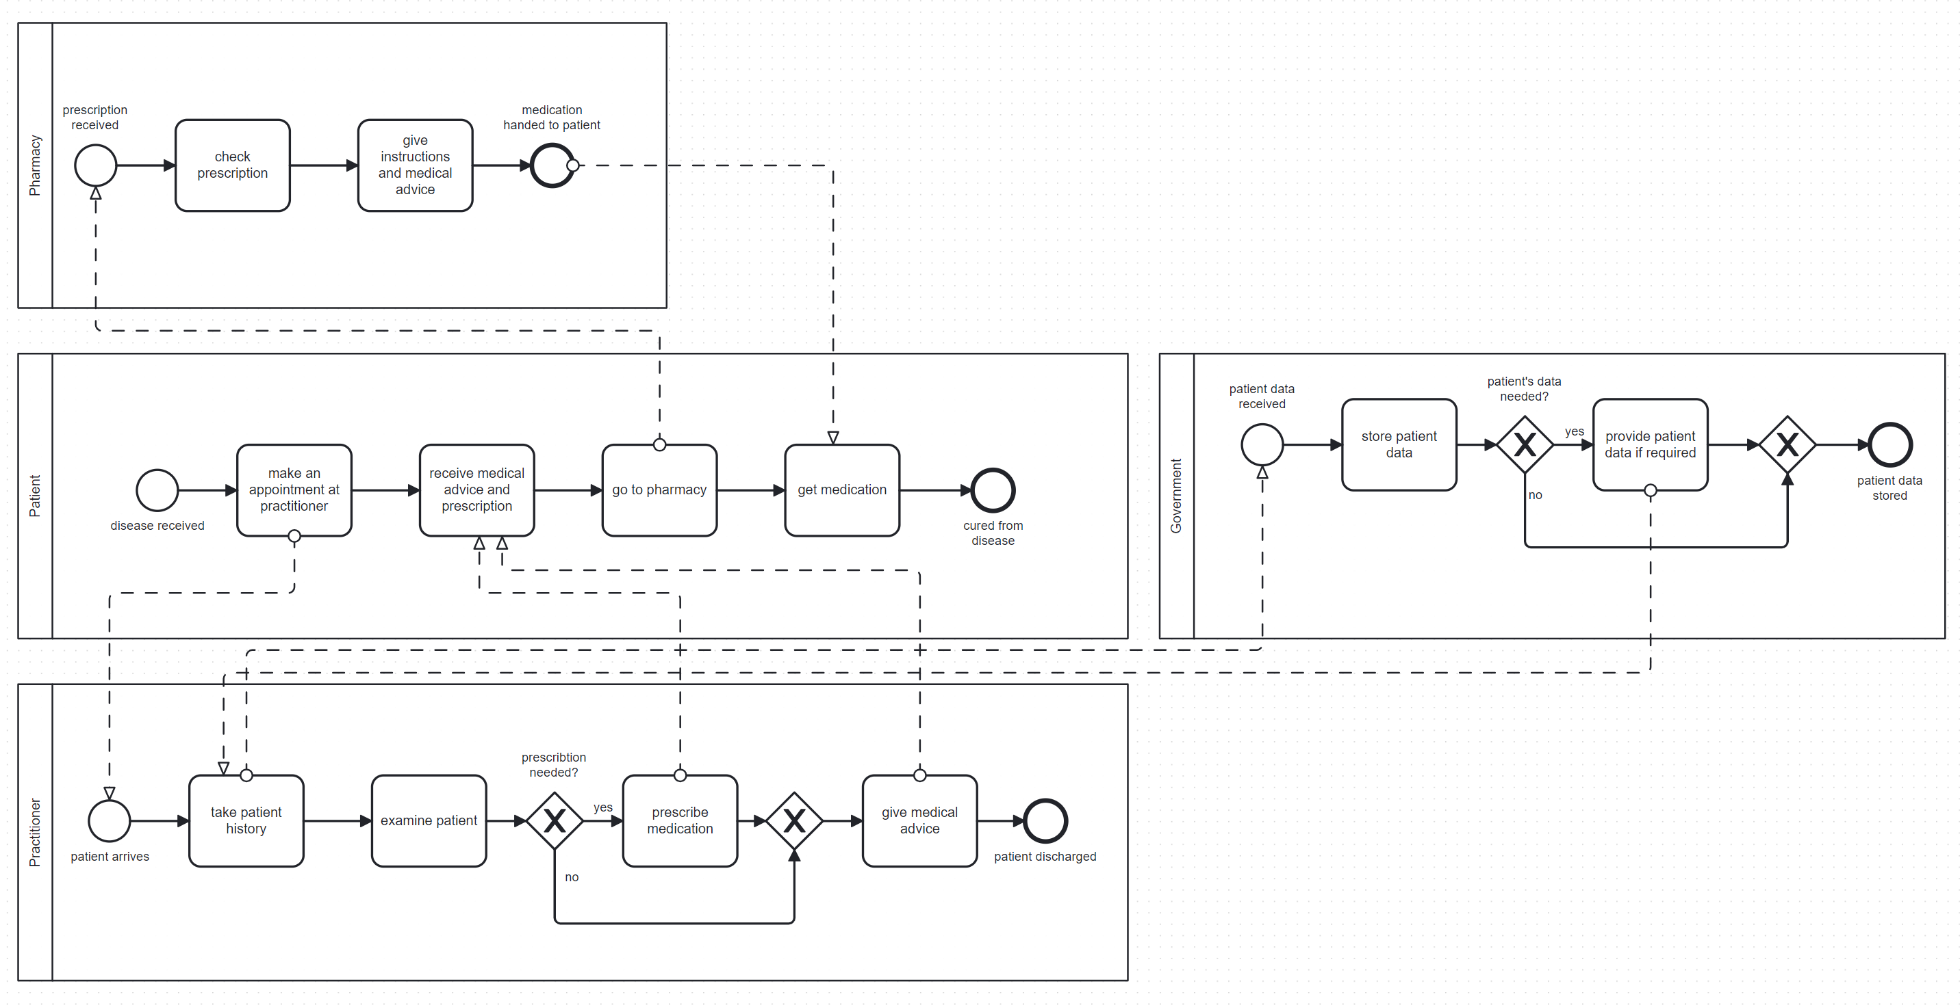
Example of current Process

Slide 4
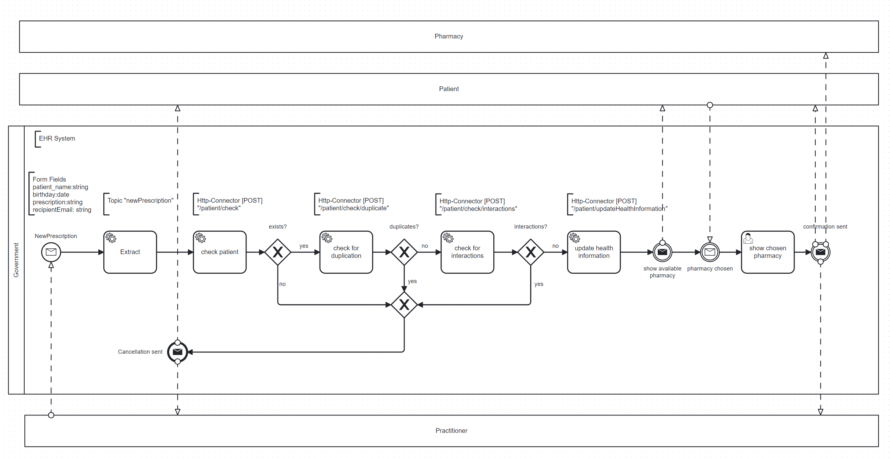
Our proposed Solution

Slide 5
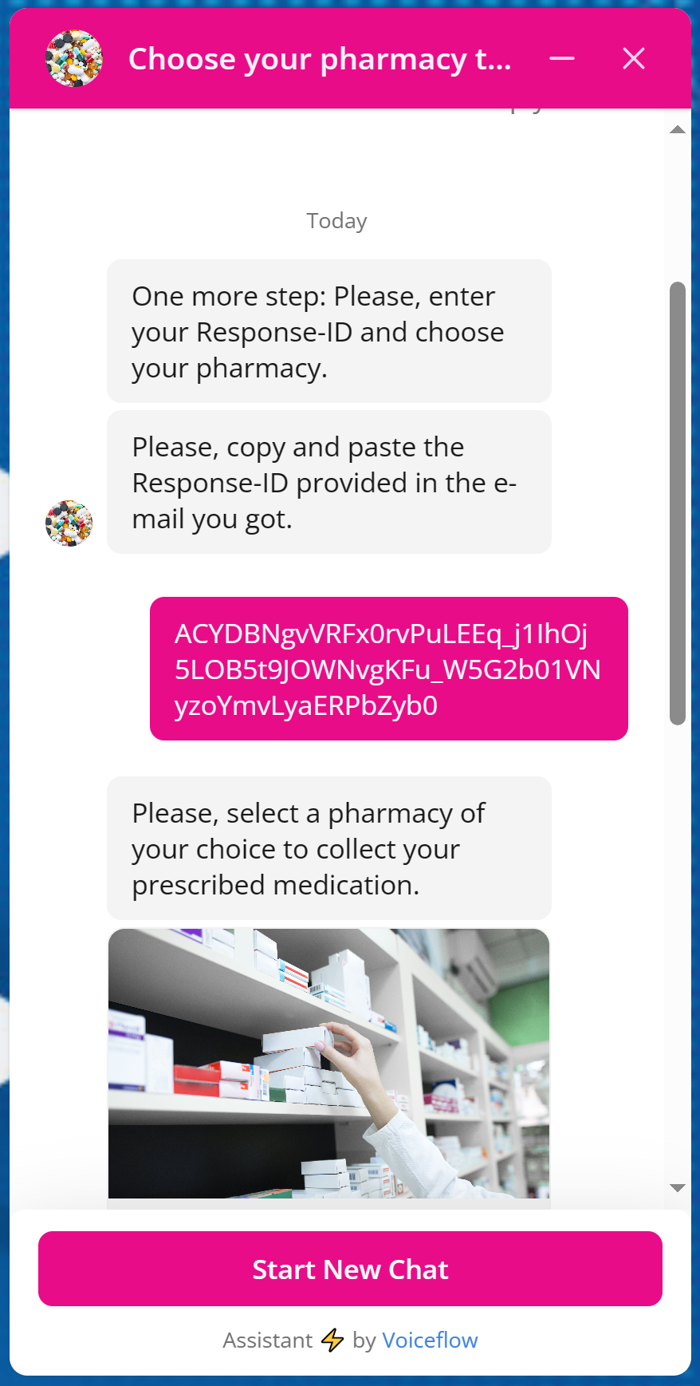
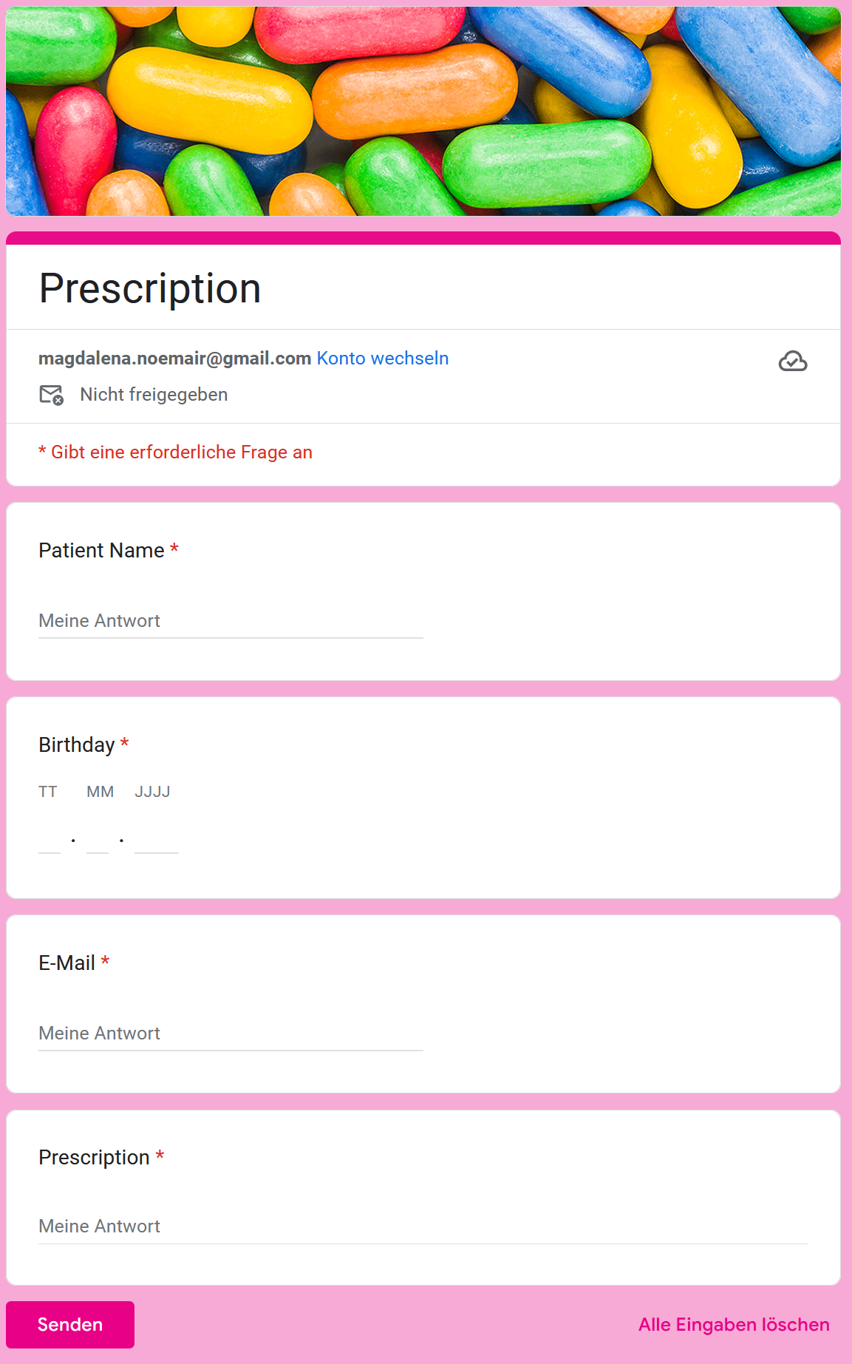
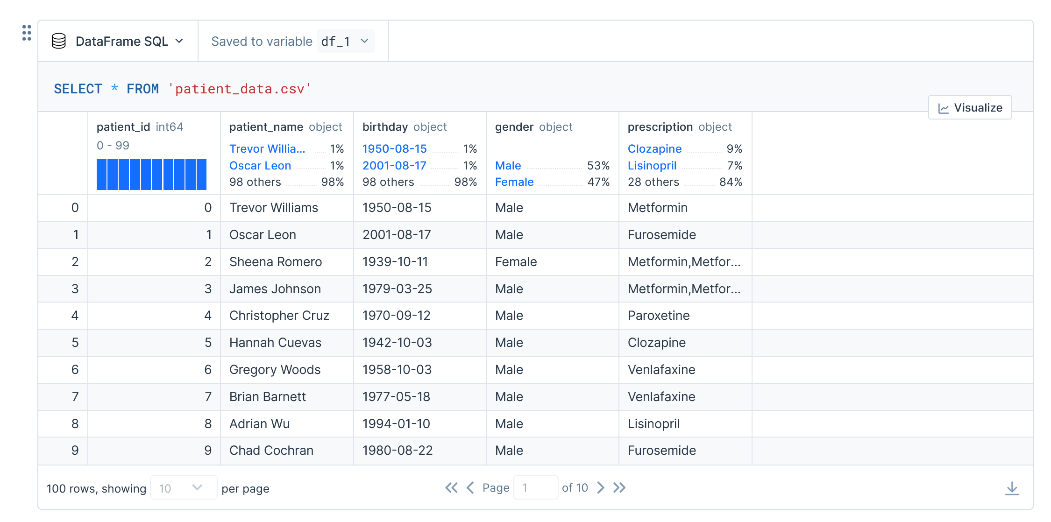
Benefits of our Process
Error prevention
All prescribed medications at a glance
Check for duplicate prescription
Check for drug interactions (via official nlm-library)
Aborts workflow if errors found and alerts customers
Paperless
No paper necessary
Resource-efficient
User friendly
Only one document for doctors
Chatbot for human-like interactions for patients

Slide 6
Disclaimer
Data privacy laws are currently not met, the team is aware of this. Meeting data privacy was not in scope of this development project
Only patients registered to the EHR-system will be able to enjoy full service
Only active pharmaceutical ingredient should be prescribed

Slide 7
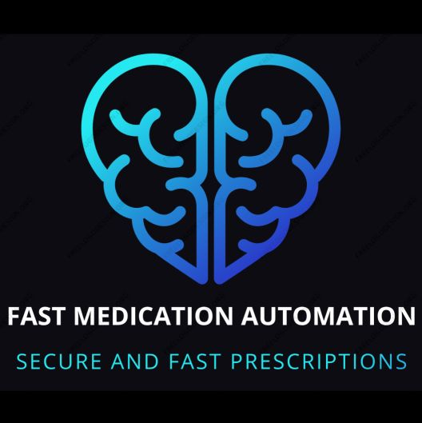

Fast medication automation
Secure and fast prescriptions!
Picture: https://www.freepik.com/free-vector/question-3d-effect-background_6209956.htm#query=questions&position=17&from_view=search&track=sph&uuid=ba74b47d-7045-44f2-b1d1-a17e8c526566">Image by pikisuperstar

